Slide 1
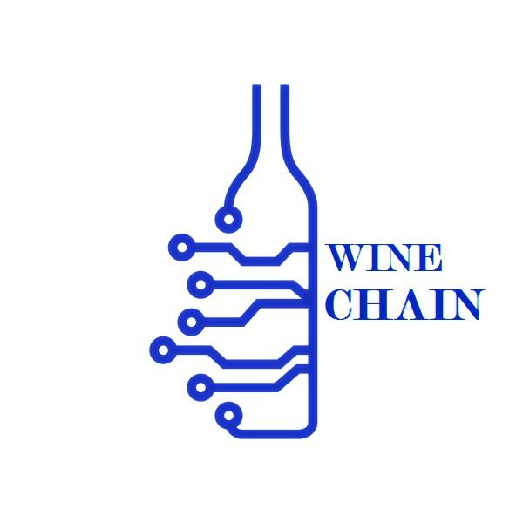
Project 3 - Use Ethereum Smart Contract
To Address Counterfeit Wine and Spirits Distribution
Monash University FinTech Bootcamp - Aug 2021
Group Members:
Shanshan Zhang
Sreeni Kalva
Cuong Phan

Slide 2
Table of Contents
1.
Project Background
2.
Current Issue & Solutions
3.
Project Analysis
4.
The Challenges

Slide 3
1.
Project Background

Slide 4
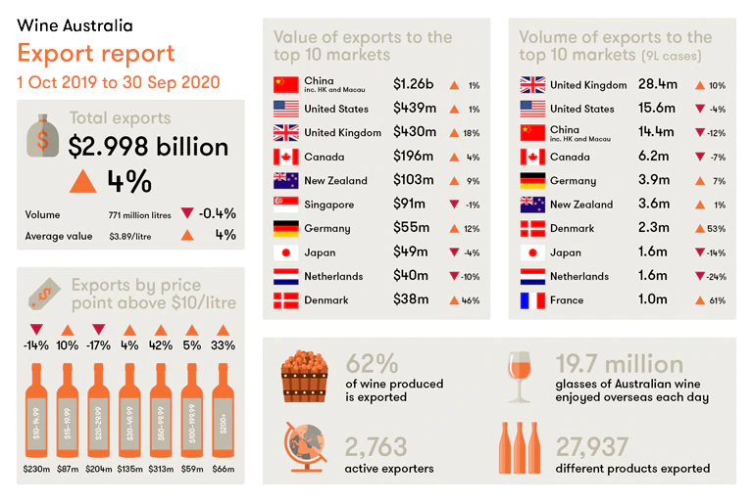
Australian wine – one of our most successful export products
Brief Info:
Fifth-largest agricultural export industry
$3.5 billion worth of domestic market for Australian wines, with Australians consuming approximately 500 million litres annually
South Australia is the country's largest wine producing state, accounting for more than half of Australia's wine grape production
“For each additional $1 million of value-add generated by the wine sector, the broader economy would gain an extra $2.19 million.”

Slide 5
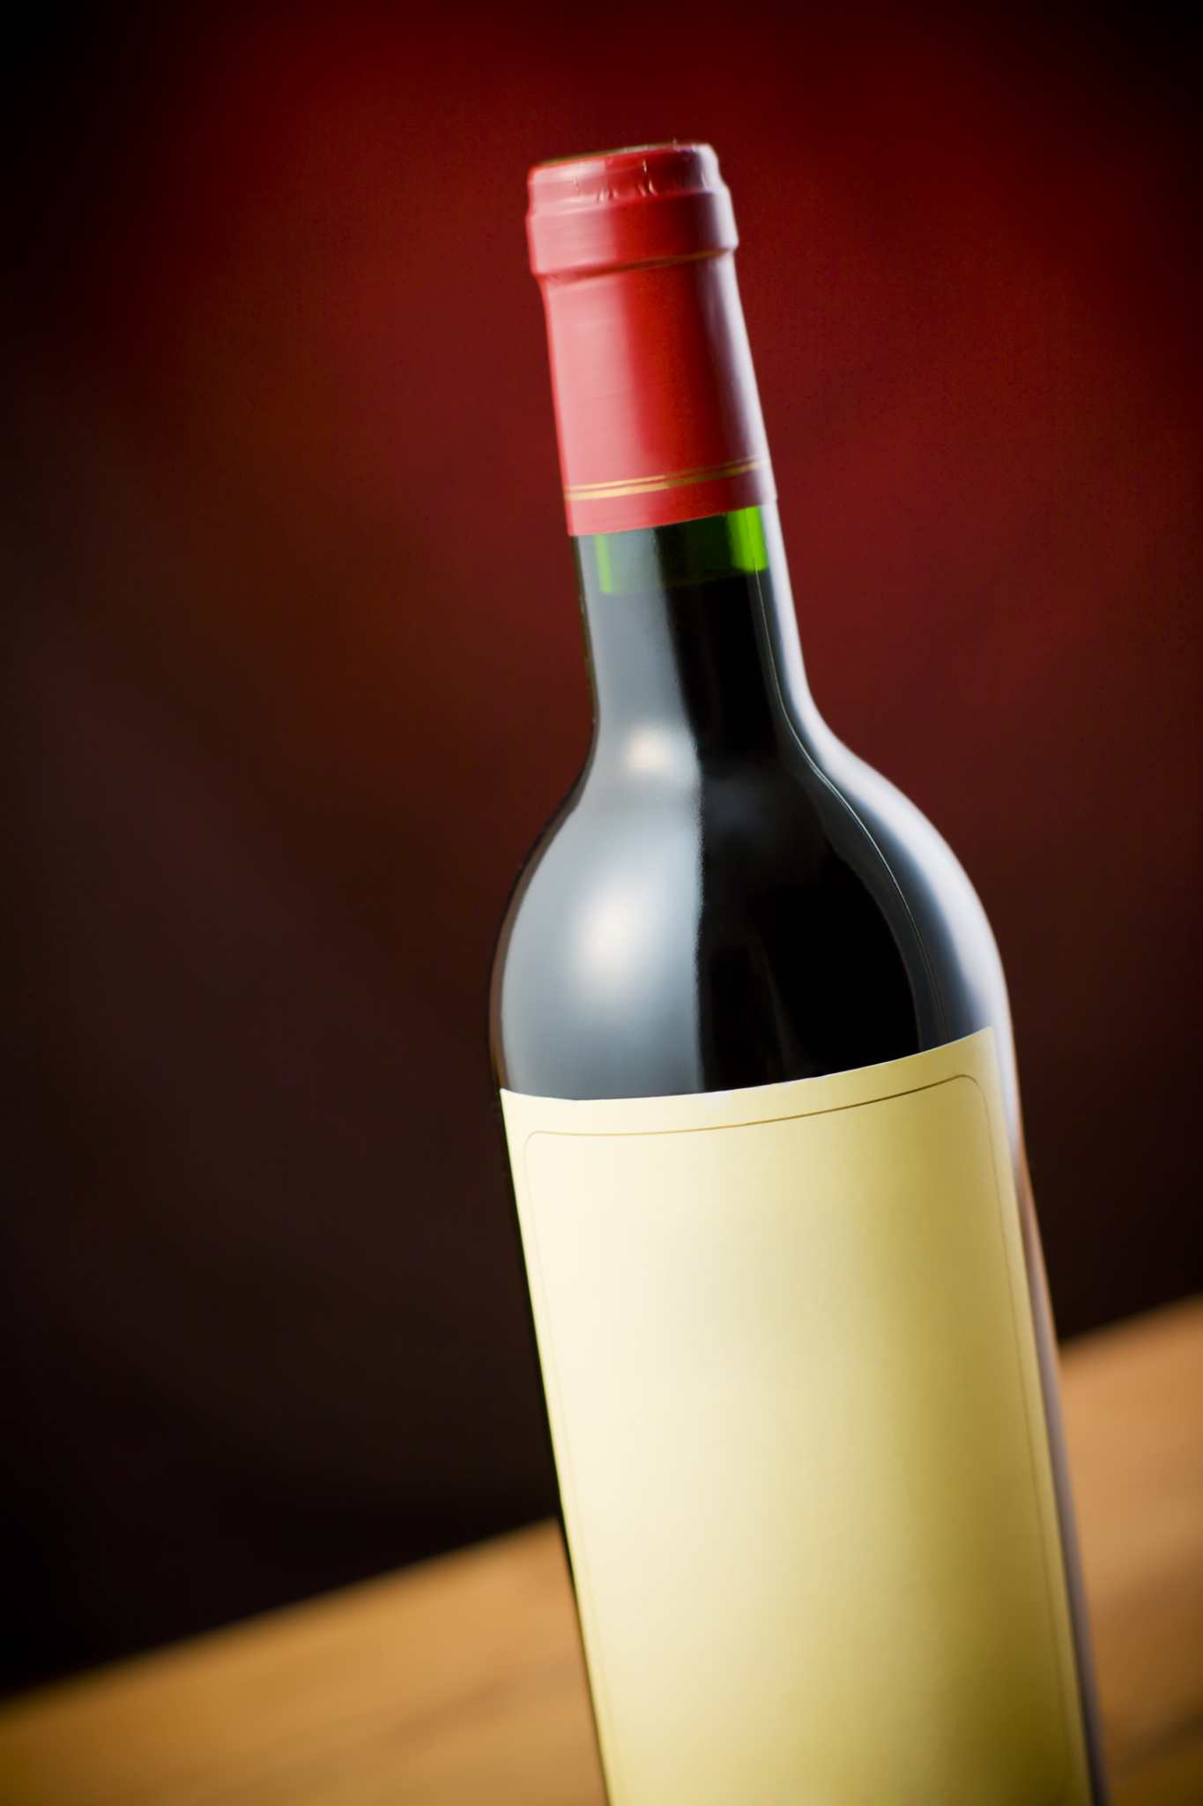
“ Where does this bottle come from? ”
Wine Export - A lucrative industry
Australia is the fifth largest wine exporter in the world.
In 2020, wine exports from Australia to China amounted to nearly 3 billion Australian dollars, making China the leading export destination for Australian wine.
Wine Counterfeit is even bigger business
Potential losses to the global industry due to counterfeits are estimated to reach $4.3 trillion by 2022.
In China alone, experts claim around 50 per cent of wine over $35 is fake, and up to 70 per cent of bottles sold are fraudulent.
“AUTHENTICITY IS A HUGE ISSUE IN MARKETS SUCH AS ASIA”

Slide 6
2.
Current Issue & Solutions

Slide 7

Traditional Supply Chain Issue:
Lack of Product Traceability
Lack of Transparency in Labeling
Poor Technology Integration
Solution:
Using the main feature of Blockchain, which are traceability, security, and decentralisation, will assuredly avail the supply chain when dealing with data around it, also streamline the financing process, and enhance coordination among buyer, supplier, and other stakeholders.
Notes:
Further, it will discussed how this and other key problems of the industry can be solved using the blockchain. My teammate will describe how to implement a decentralized distribution register in the wine industry's sales chain and what it will give to producers, consumers and society as a whole.

Slide 8
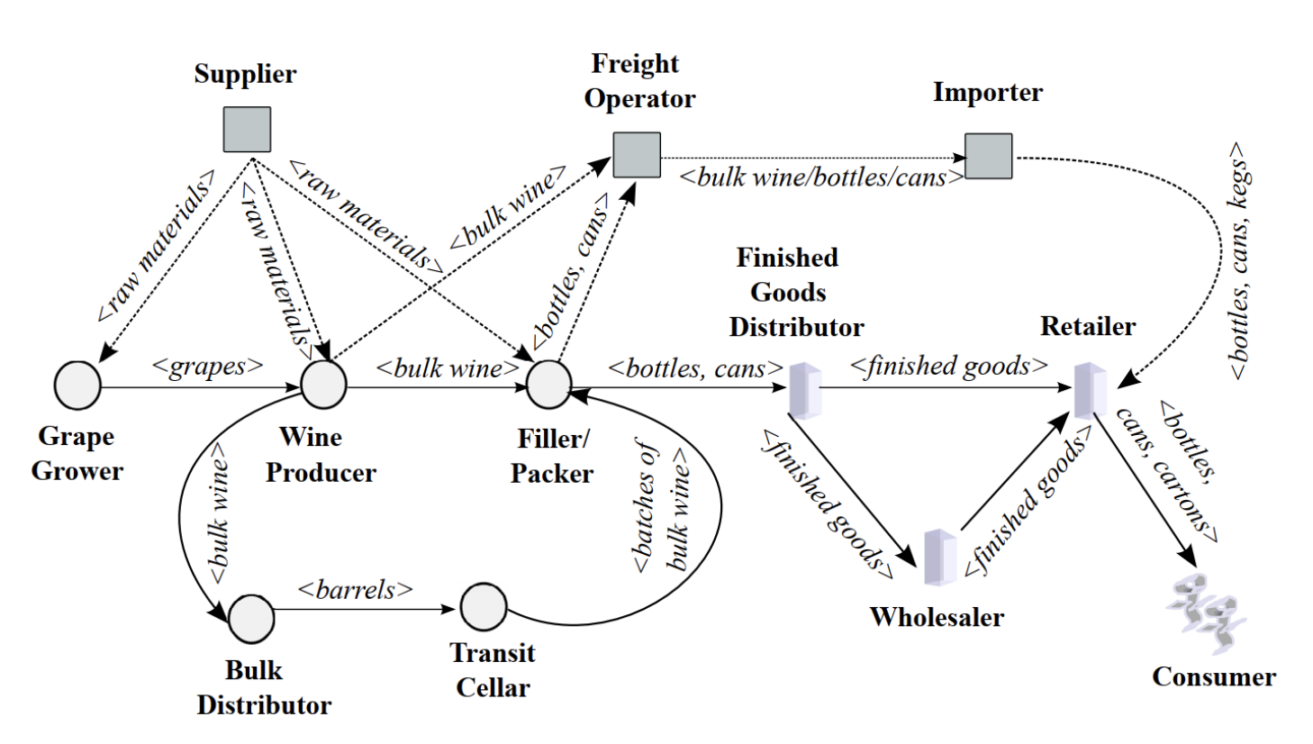
How to implement blockchain in the supply chain of wine products

Slide 9
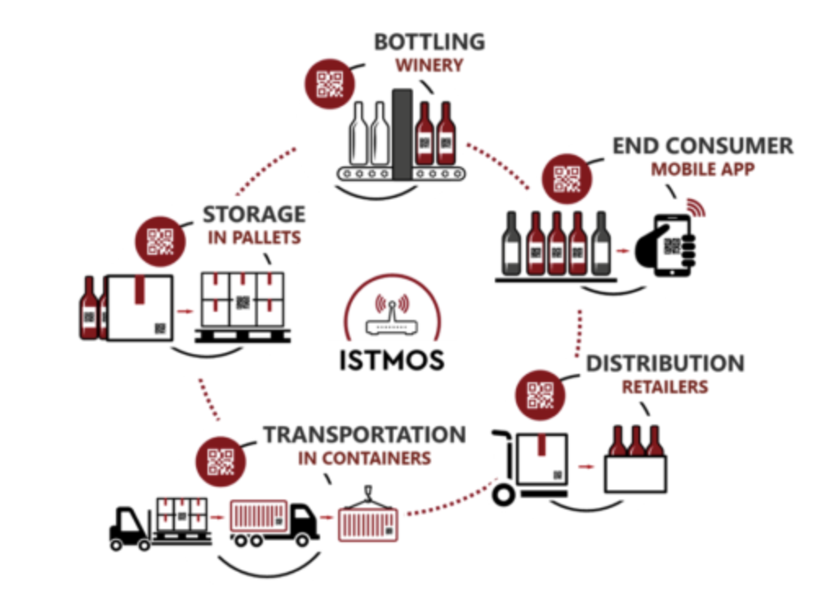
# 1. Winemakers
Integration of the blockchain at this stage means the following actions:
A network of sensors is being created that automatically collects data on weather, soil conditions and other factors that affect the quality of the grapes in a particular season (production cycle).
After harvesting and squeezing the juice, the information about the date of this procedure, grapes variety, location (country of origin) , etc. is entered into the system.

Slide 10
# 2. Wholesale Distributor
These are people or structures responsible for obtaining wine from winemakers, mixing them and sending the finished product to a transit cellar or packer. Wholesale distributors contribute to blockchain:
Date of obtaining, data on the conditions of transportation and storage.
Information on processing, sampling, analysis of bulk wine and the date of dispatch.
If the blending process is performed, this is also recorded in the blockchain.

Slide 11
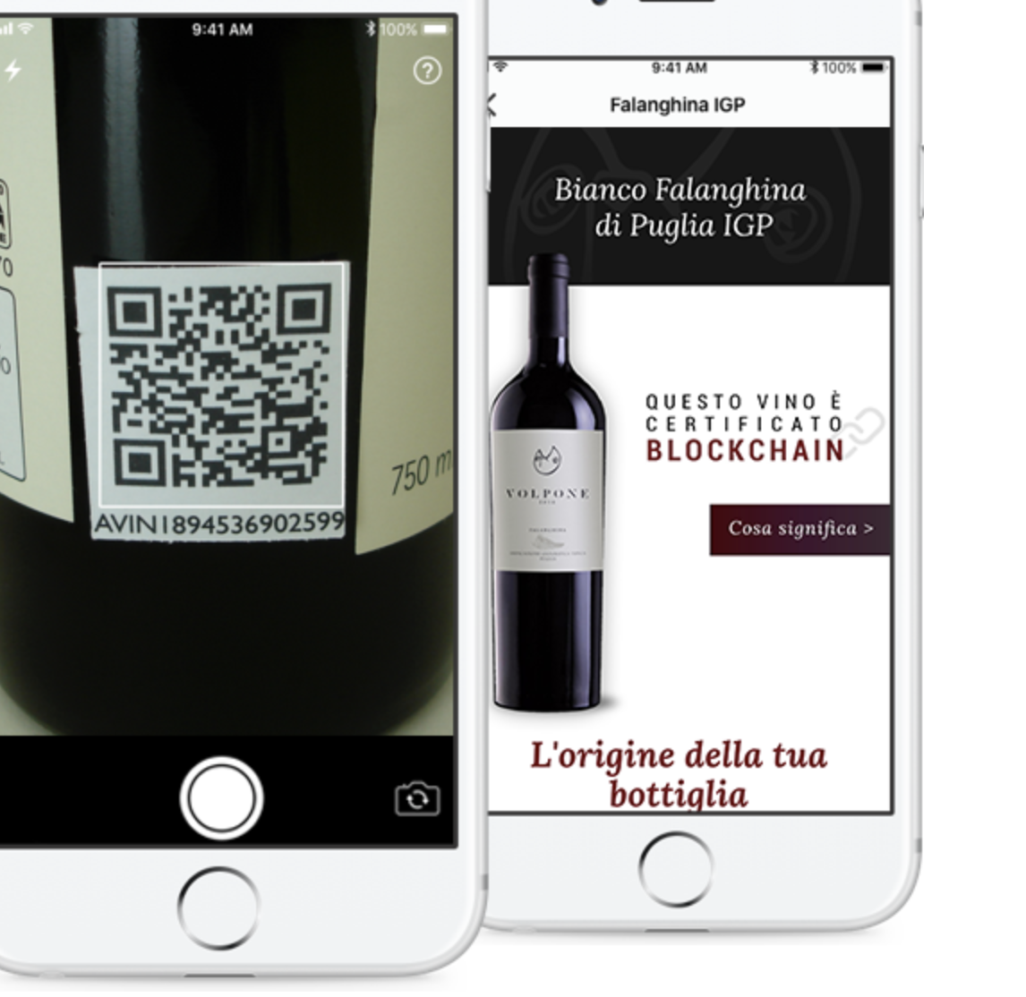
# 3 Packer / Inspector
At this stage are carried out the identification and labelling of the goods. For the correct use of the blockchain, it is important to ensure the consistency of such labeling between different market participants. This refers to two types of data:
Directly about the product and production: reception, storage, processing, sampling, analysis, filling, packaging and shipping of finished products.
Information about counterfeit protection: paper types, laser embossing, hot and cold foil embossing, heat-sensitive paints, holograms, hot stamping and other.

Slide 12

# 4 Distributor of finished products
What needs to be reflected in the blockchain:
Reception date, storage conditions and date of shipment.
Repackaging and remarking information.
Information about the destination of the goods.

Slide 13
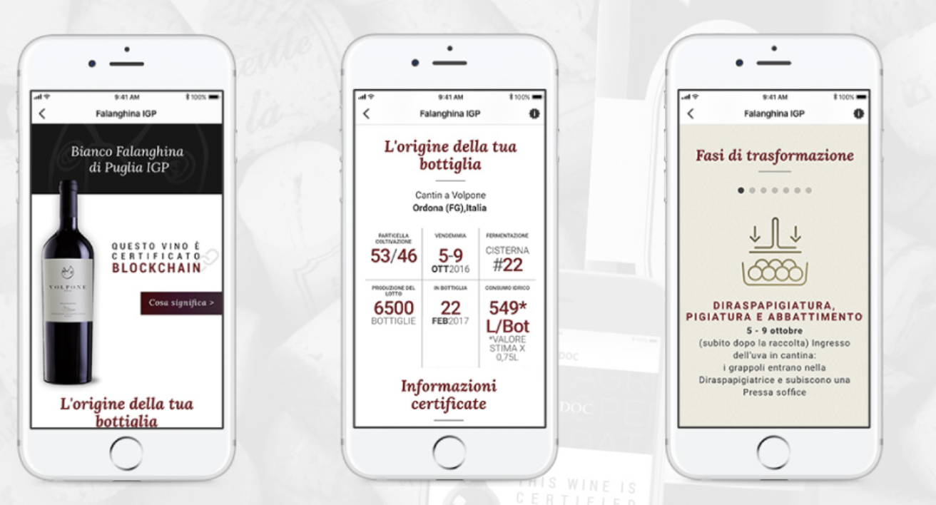
# 5. Retail
The retailer receives finished products in the form of bottles, cans, barrels and cardboard boxes from the distributor of finished products or the wholesaler and sells them to final consumers.
Retail is responsible for displaying in the network information about goods received, their storage and sale.
The sale must be logged so that the same identification tag cannot be reused.

Slide 14
3 .
Project Analysis
-Winechain 1.0

Slide 15
WINECHAIN VISIBILITY 1.0
CUSTOMS OFFICER
SHIPPED TO DISTRIBUTOR
AND THEN TO
Quality Inspector
RETAILER
Wine Producer
SHIP TO PORT
CONSUMR
WineChain records the information from the wine producer about the product i.e. type of grapes, place of origin, manufactured date, lot number etc. For increased quality assurance, an independent or an export association body could undertake quality check and records their findings using their public key. When this product lot reaches the shipping port, the customs officer records other supplementary information such as product origination company and linking the product to the wine producer. All this information is recorded on the smart contract and is available for international retailer / consumer to review and be assured of its authenticity prior to purchase. This wine chain also facilitates direct payments from Retailer/Distributor to Wine Producer eliminating the process overheads and also with improving cash flows.

Slide 16
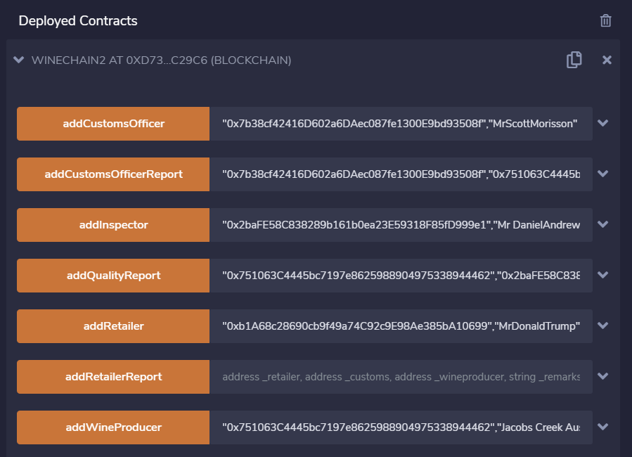
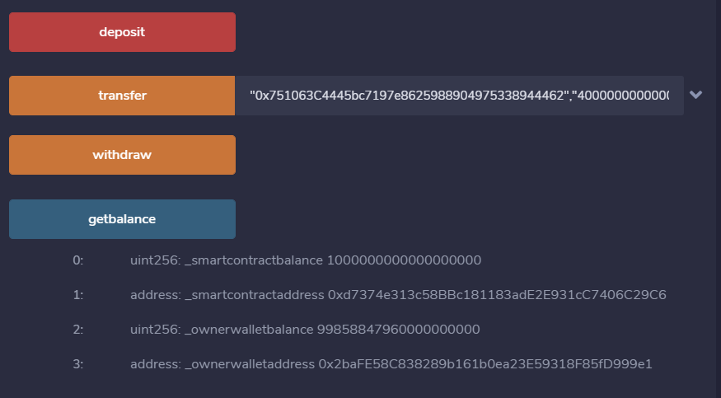
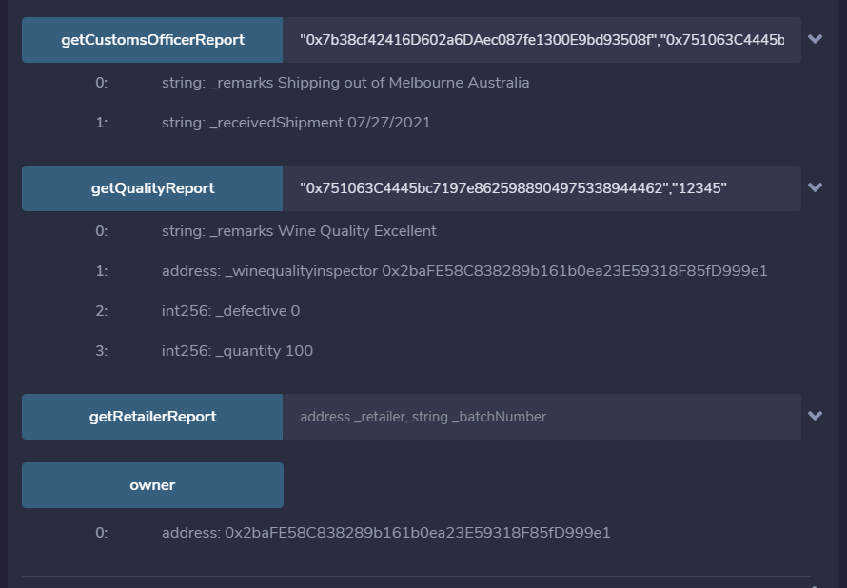
Functions in the Wine chain Smart Contract to facilitate the payments from retailer to wine producer directly, and for checking balance in smart contract.
Functions in the Winechain SmartContract to assure authenticity of the product.

Slide 17
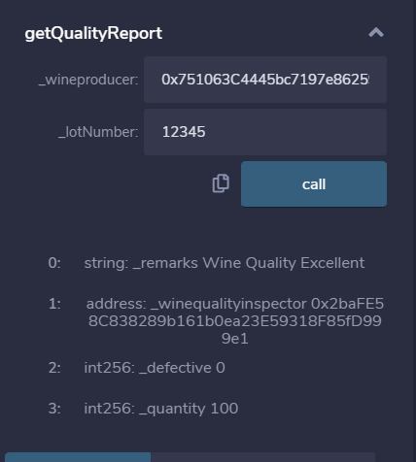
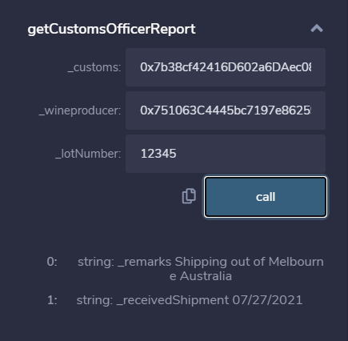
A retailer or consumer can get assurance of the wine authenticity prior to purchase, by retrieving reports from Quality Inspector and from Custom Officer

Slide 18
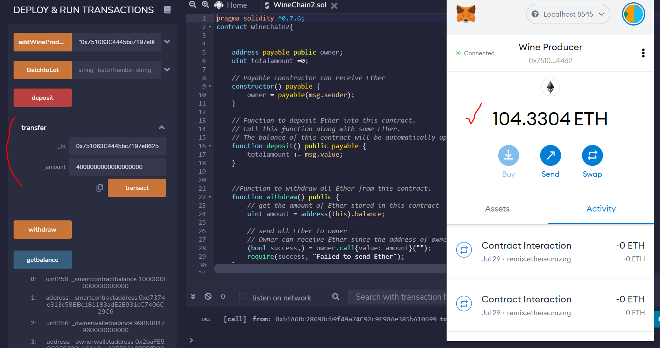
A retailer can make payment directly to the producer without any intermediate parties.

Slide 19
4.
The Challenges

Slide 20
Despite the significant opportunities presented by using blockchain technology in the wine sector, there are many barriers to adoption. These barriers include:
Cost of the solution ‘perceivably’ be higher than the benefits
limited interest in, and capacity for, technological adoption
lack of digitisation in parts of the agricultural sector
limited access to capital to adopt solutions
limited access to digital infrastructure
slow adoption curve due to low risk appetite
limited understanding of blockchain technology and/or a sense that the technology is overhyped or not appropriate for this use case
a lack of incentive to innovate
uncertainty regarding the impact of increased transparency and unease with data usage, storage and control.

Slide 21
Thanks!
Any questions?

